Slide 1
Where is Investment Going in Vietnam
Maxfield Brown
Manager, Business Intelligence

Slide 2
Table of Contents
Vietnamese FDI in 2019: Review of H1 Statistics
Mapping Vietnamese Investment Inflows
Developing a Location Specific Investment Strategy in Vietnam

Slide 3
Vietnamese FDI in 2019
H1 Statistics

Slide 4
FDI in 2019
Catalysts
Performance As of May 2019
Projects
New | Increasing Capital
1363 | 505
+26% | +28%
Notes:
Manufacturing now captures over 70% of the capital flowing into Vietnam

Slide 5
Industry FDI Trends (2018 vs 2019)
Notes:
Manufacturing now captures over 70% of the capital flowing into Vietnam

Slide 6
Investor FDI Trends (vs 2018)
New FDI Projects May 2019 vs May 2018
New FDI Projects May 2019 vs May 2018
 | 2018 |  | 2019
South Korea | 381 |  | 395
Japan | 164 |  | 233
China | 128 |  | 165
EU | 82 |  | 113
Singapore | 78 |  | 98
Hong Kong | 51 |  | 80
Taiwan | 46 |  | 60
USA | 35 |  | 46
Investment up across the board
Investment from mainland China nearly doubles
Investment from regional management centers servicing China and APAC on the rise
Continued interest from Japanese and Korean investors
European Investors appear to be taking a wait and see approach as the EU – Vietnam FTA nears implementation.

Slide 7
Mapping FDI Flows

Slide 8
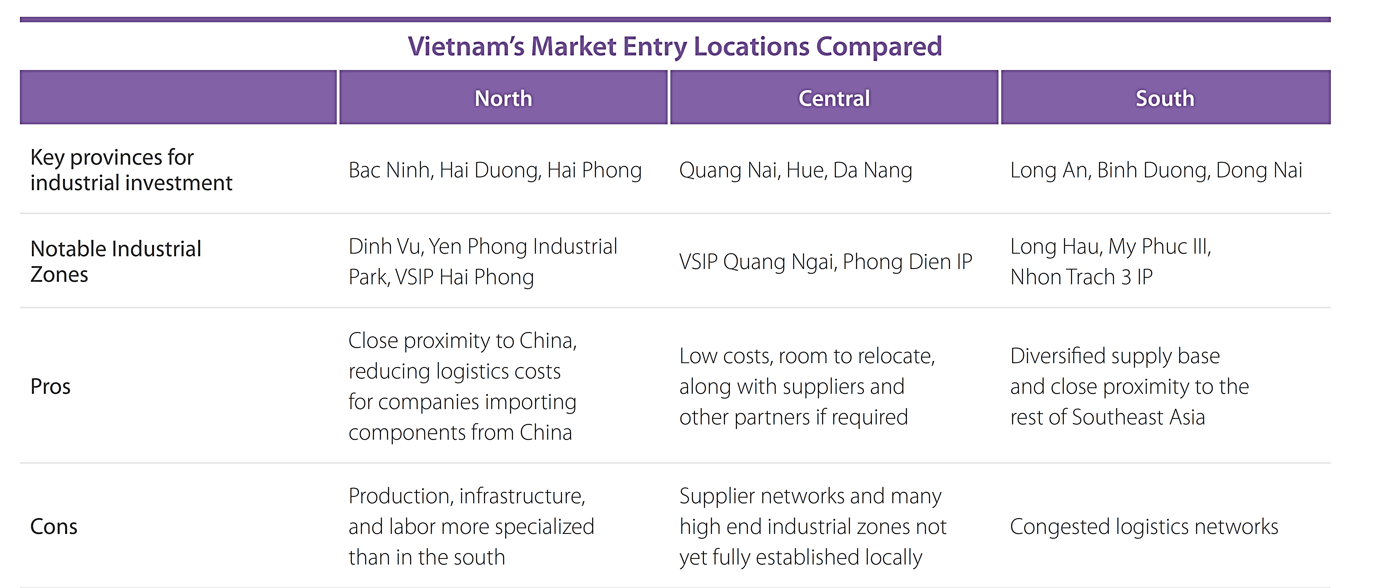
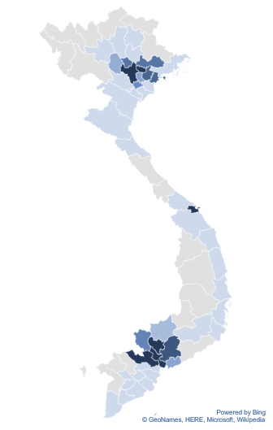
Distribution of FDI in 2019

Slide 9
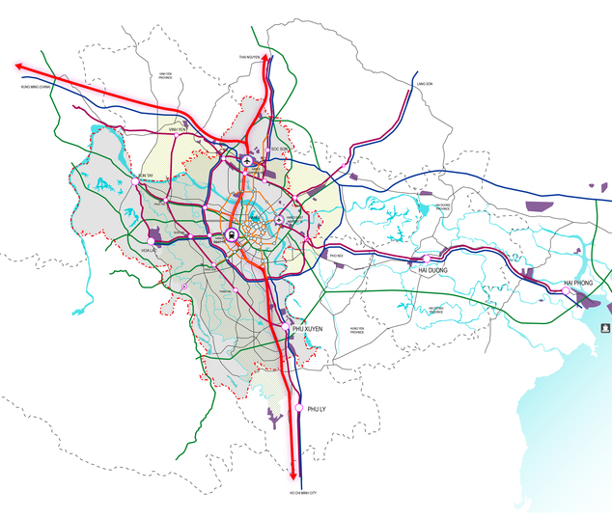
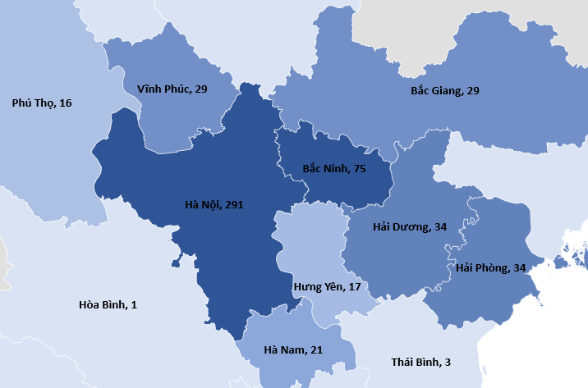

Northern FDI Projects
Mapping FDI Projects in Northern Vietnam
Infrastructure Networks in Northern Vietnam

Slide 10
Northern FDI Trends
Distribution of FDI Projects in Northern Vietnam (May 2019)
Change in Distribution of FDI Projects (May’15 vs May’19)

Slide 11
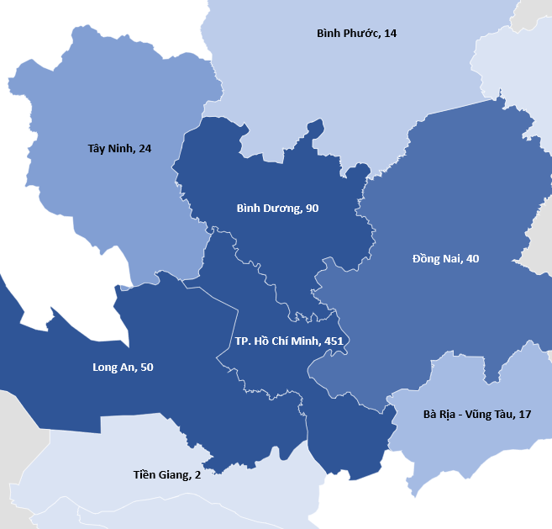
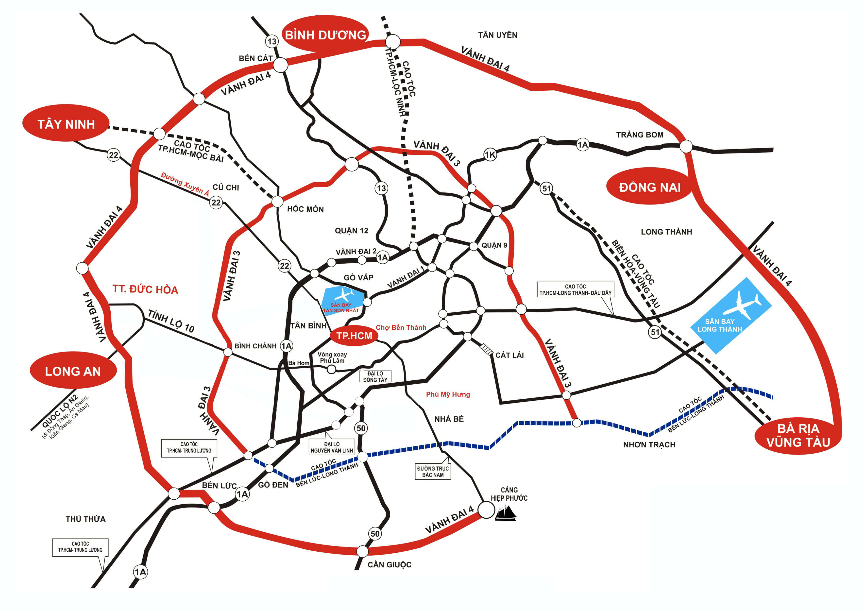
Southern FDI Projects
Mapping FDI Projects in Southern Vietnam
Infrastructure Networks in Southern Vietnam

Slide 12
Southern FDI Trends
Distribution of FDI Projects in Northern Vietnam (May 2019)
Change in Distribution of FDI Projects (May’15 vs May’19)

Slide 13
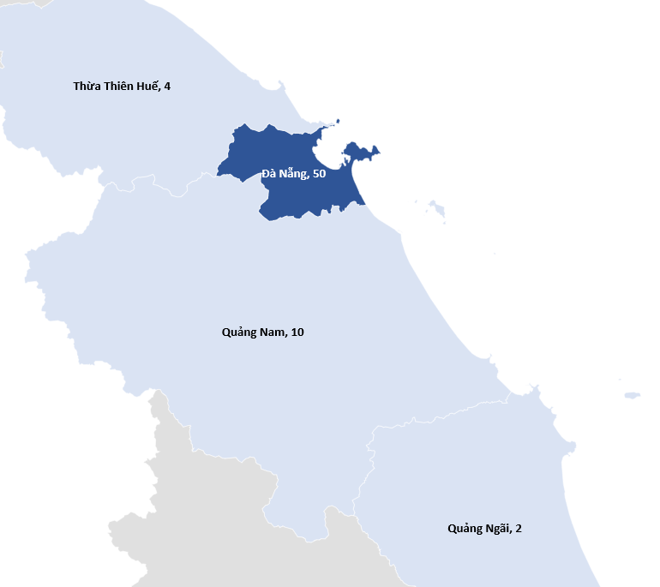
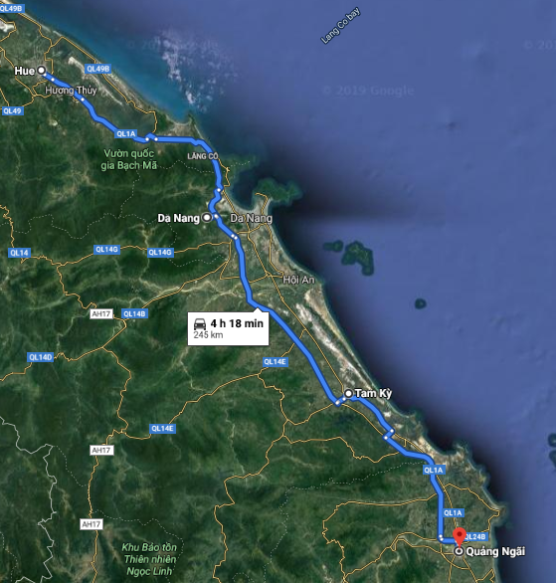
Central FDI Projects
Mapping FDI Projects in Southern Vietnam
Infrastructure Networks in Southern Vietnam

Slide 14
Central FDI Trends
Distribution of FDI Projects in Central Vietnam (May 2019)
Change in Distribution of FDI Projects (May’15 vs May’19)

Slide 15
Developing a Location Specific Investment Strategy

Slide 16
Developing a Location Specific Strategy
Why Vietnam?
How does my supply chain need to be adjusted?
Which location can support these requirements?
What are my options within this location?

Slide 17
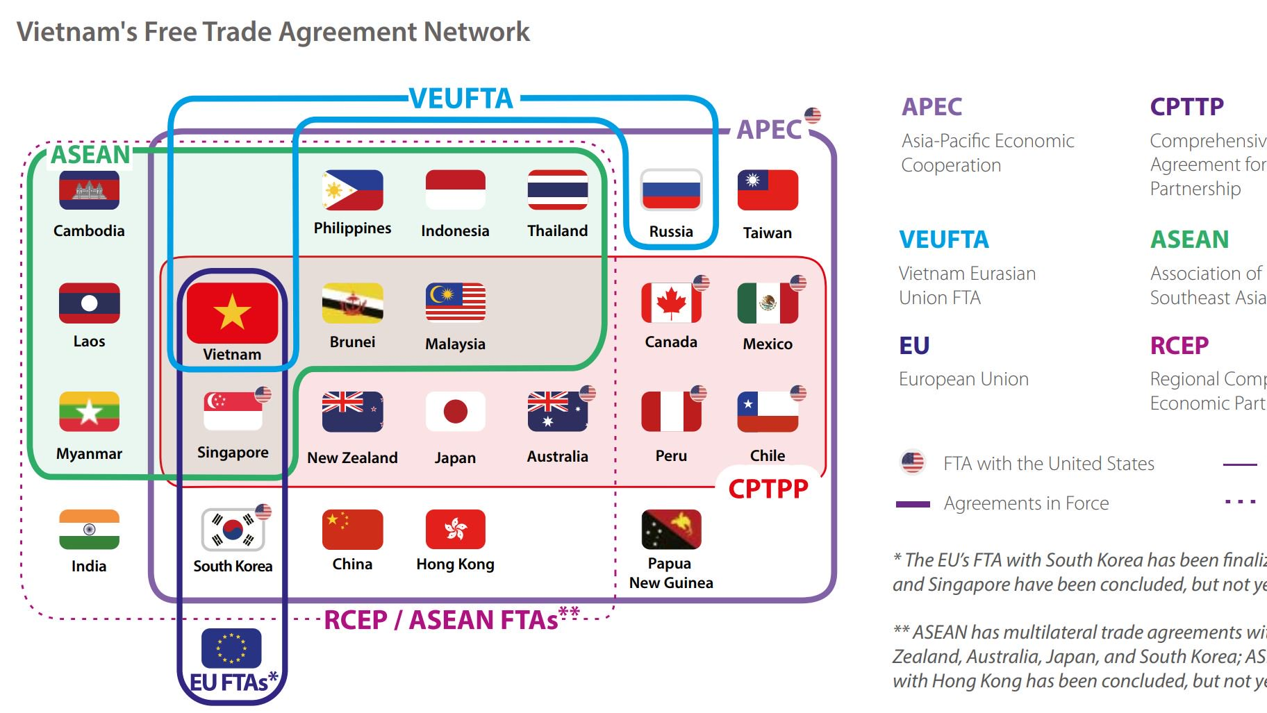
Understanding the Costs of Global Sourcing
How does my supply chain need to be adjusted?
Which location can support required adjustments?
What are the next steps?

Slide 18
Shifting the Origin of Products to “Made in Vietnam”
How does my supply chain need to be adjusted?
Which location can support required adjustments?
What are the next steps?
 | Type of Operation | Activities in China | Activities in 3rd party market | Location of suppliers | Ability to change origin of good away from China
1 | China | Manufacturing & Assembly | N.A. | China | 0%
2 | China +1 | Manufacturing & Assembly | Finishing & Packaging | China | Very Low
3 | China +1 | Manufacturing | Assembly | China | Low
4 | China +1 | Manufacturing | Manufacturing + Assembly | China + 3rd party market | Medium
5 | Full Relocation | N.A. | Manufacturing + Assembly | China + 3rd party market | High
6 | Full Relocation | N.A. | Manufacturing + Assembly | 3rd party markets | 100%

Slide 19
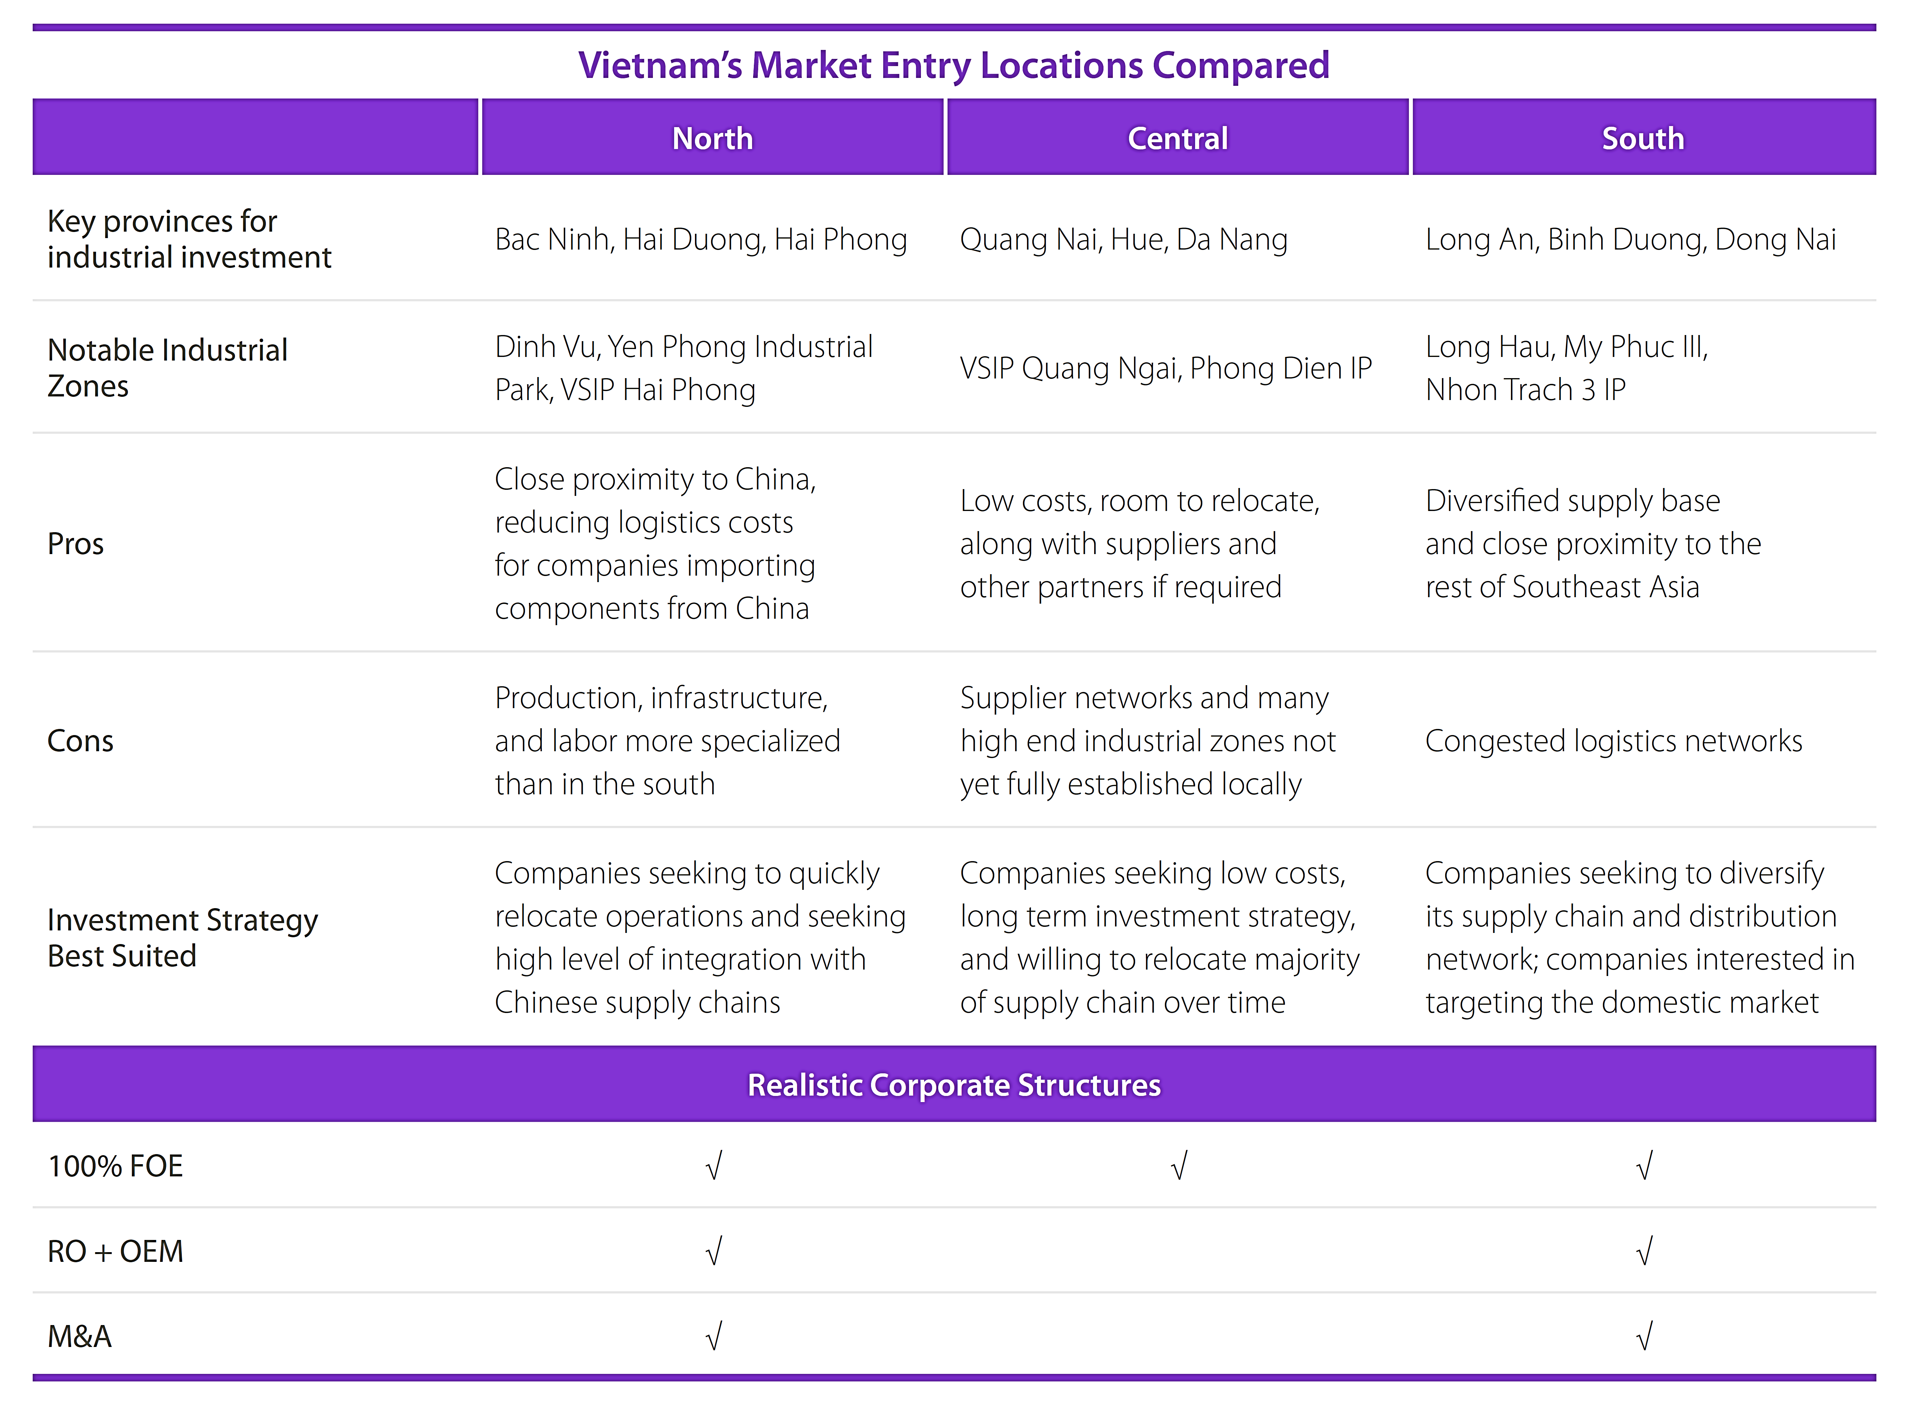
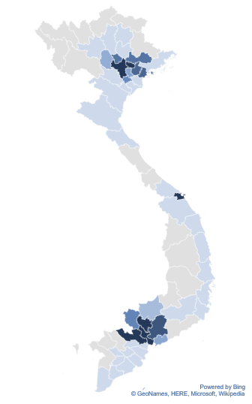
Findings a Location that Suits Your Production Strategy
How does my supply chain need to be adjusted?
Which location can support required adjustments?
What are the next steps?

Slide 20
Next Steps
Select a desired corporate structure
Identify land or facilities of interest
Schedule market visit to better understand facilities and to meet with partners
Identify partners of interest
How does my supply chain need to be adjusted?
Which location can support required adjustments?
What are the next steps?

Slide 21
How to Set Up in Vietnam
Trent Davies, Manager
International Business Advisory

Slide 22
1. Corporate Structures
2. Four Step Set Up Guide
3. Compliance: Taxes, Accounting, Audits and Remittance

Slide 23
Corporate Structures

Slide 24
Key Market Entry Options
Representative Office
Companies looking to understand the Vietnam market or for support for entities outside of Vietnam
None
100% Foreign Owned
(LLC or JSC)
Companies involved in unrestricted sectors seeking to retain complete control
Sufficient capital
JV / M&A
Investors seeking access to conditional sectors, Vietnamese consumers or logistic networks
6 – 8 weeks
Time to find location +
2 – 4 months
Best suited for
Capital Requirements
Setup time
Liability
Subject to industry.
Minimum requirements applied to conditional sectors
Limited to VN entity
Full liability with parent
2 – 4 months + negotiation
Limited to charter

Slide 25
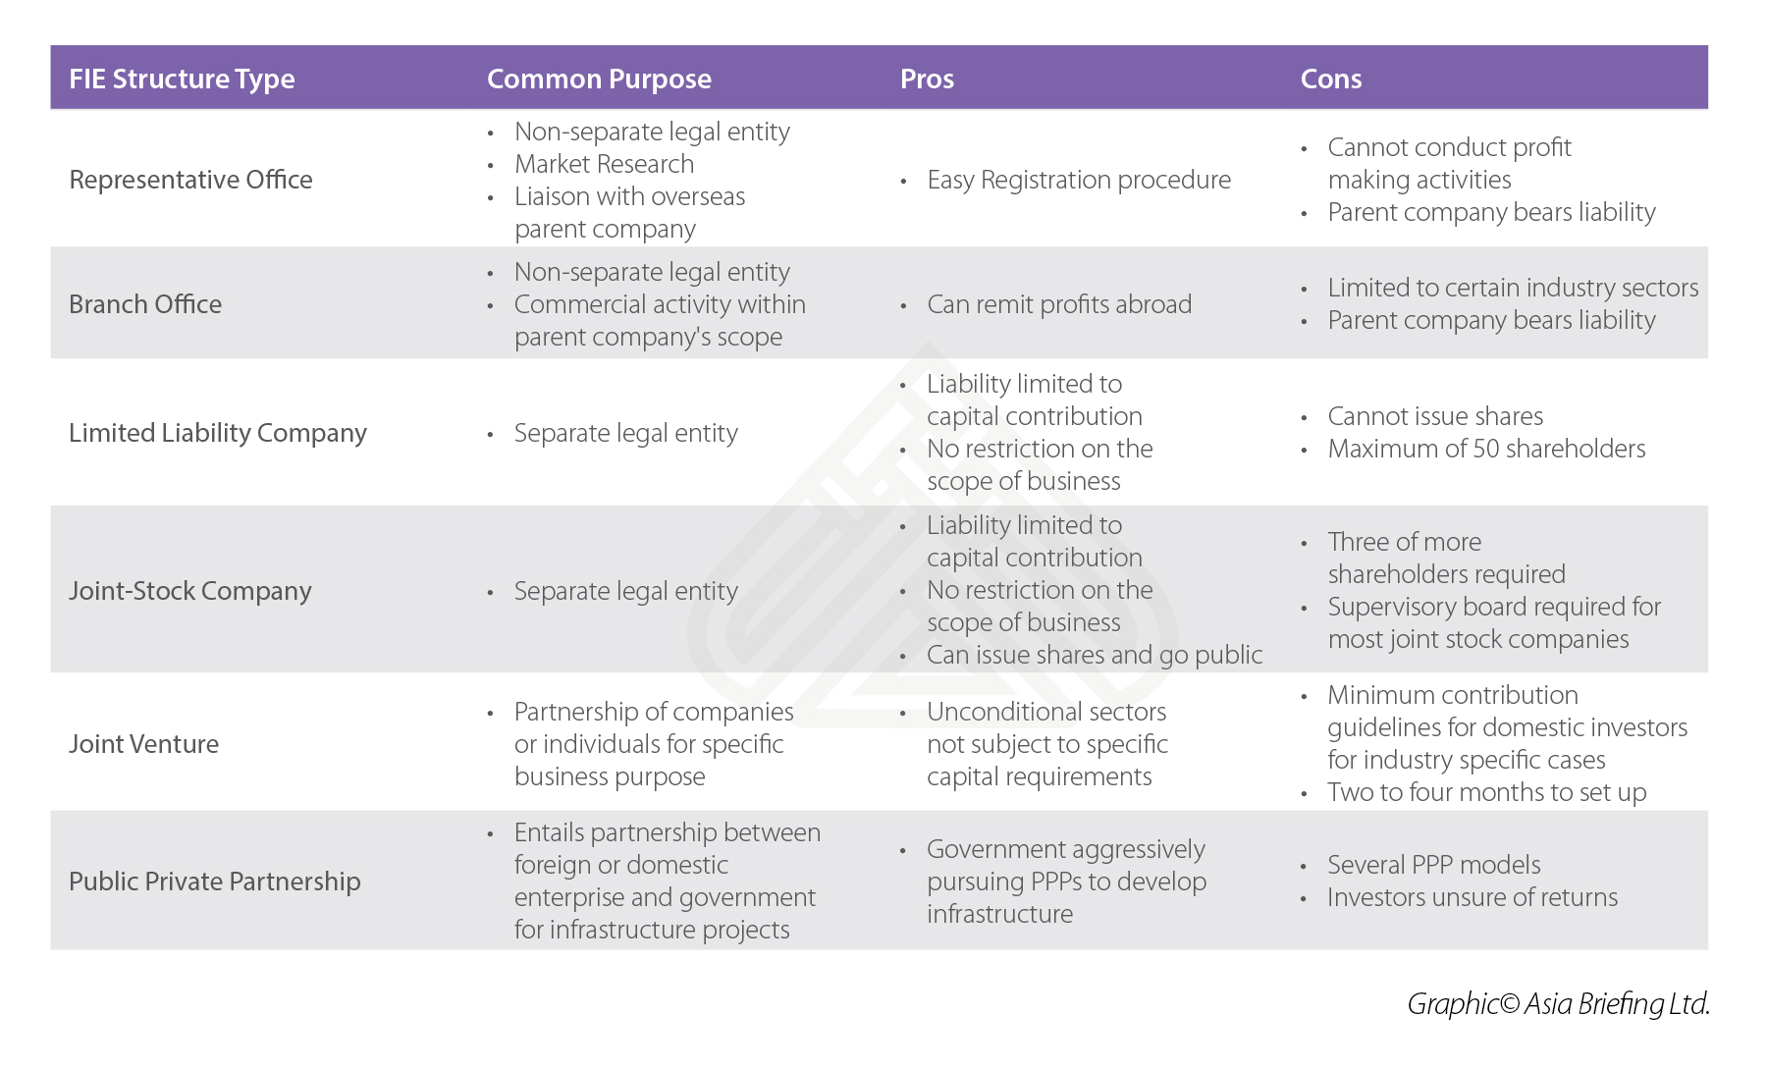

Slide 26
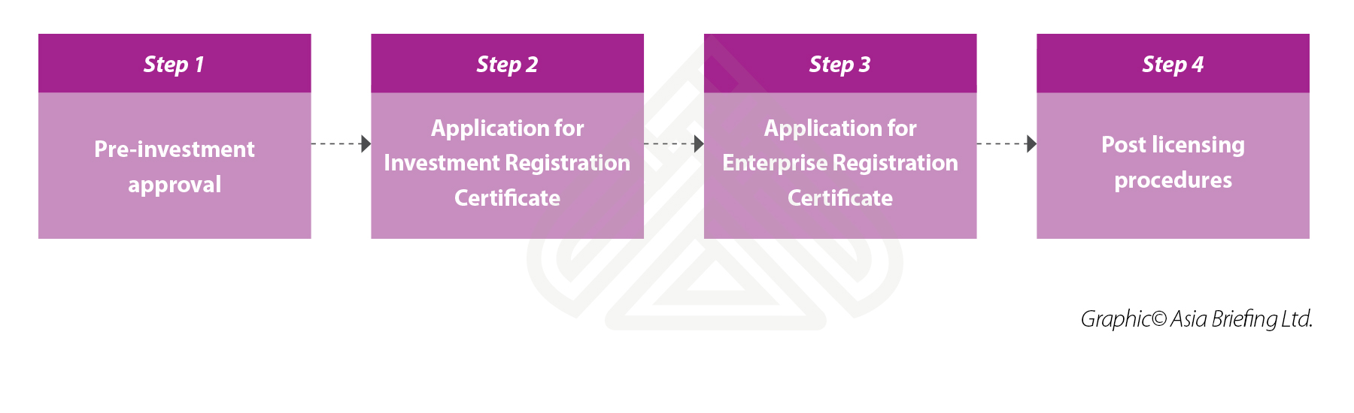
Four Step Set Up Guide
Conditional sectors
Location selection
Environment impact assessment
Certificate of land use
Construction permits
Implementation of investment project
Details of project
Total investment/capital
Financial Statements
Timeframe: 15 w/days
Company charter
List of all board members
List of legal representatives
Letters of appointment and authorization
Timeframe: 3 w/days
Seal carving
Bank account opening
Labor registration
Business licenses tax payment
Charter capital contribution (90 days)
Public announcement

Slide 27
How can foreign investors set up a factory in Vietnam?
1. Rent existing factory
2. Rent land and build
“tailor-made” factory
3. Use of LURs and
build a “tailor-made”
factory
4. Use of LURs and
existing factory
Non Conditional
Conditional
Restricted
Location selection
Environment impact assessment
Certificate of land use
Construction permits
Apply for Investment Registration Certificate – IRC
(15 wd)
Apply for Enterprise Registration Certificate – ERC
(3 wd)
Post licensing steps
Additional Licenses
Capital contribution
Statutory compliance begins (tax, labor, etc.)
Bank account opening (KYC, 90 days for capital contribution)
Commence operations
Greenfield
Equity acquisition Asset acquisition
Merger
LLC
JSC
Subsidiary
RO
WFOE or JV

Slide 28
Vietnam Taxes in a nutshell
Corporate Income Tax (20%) / Capital Gains Tax (20%)
No withholding tax on dividend/profit repatriation
Value Added Tax (10% standard, 5%, 0%, exempt)
Personal Income Tax (Residents 5% - 35%, Non Resident 20%)
Customs Duties
Business License Tax
Special Consumption Tax (SCT) / Foreign Contractor Tax (FCT)

Slide 29
Vietnam’s Compulsory Insurances
Total contribution of 32% for Social insurance, Health Insurance, Unemployment insurance
As of Jan 2018 expats must pay Social Insurance
SHUI | Employer | Employee
Social (SI) | 17.5% | 8%
Health (HI) | 3% | 1.5%
Unemployment (UI) | 1% | 1%
TOTAL | 21.5% | 10.5%
Calculated on salary but capped at 20 times statutory minimum salary ~27,000,000vnd.

Slide 30
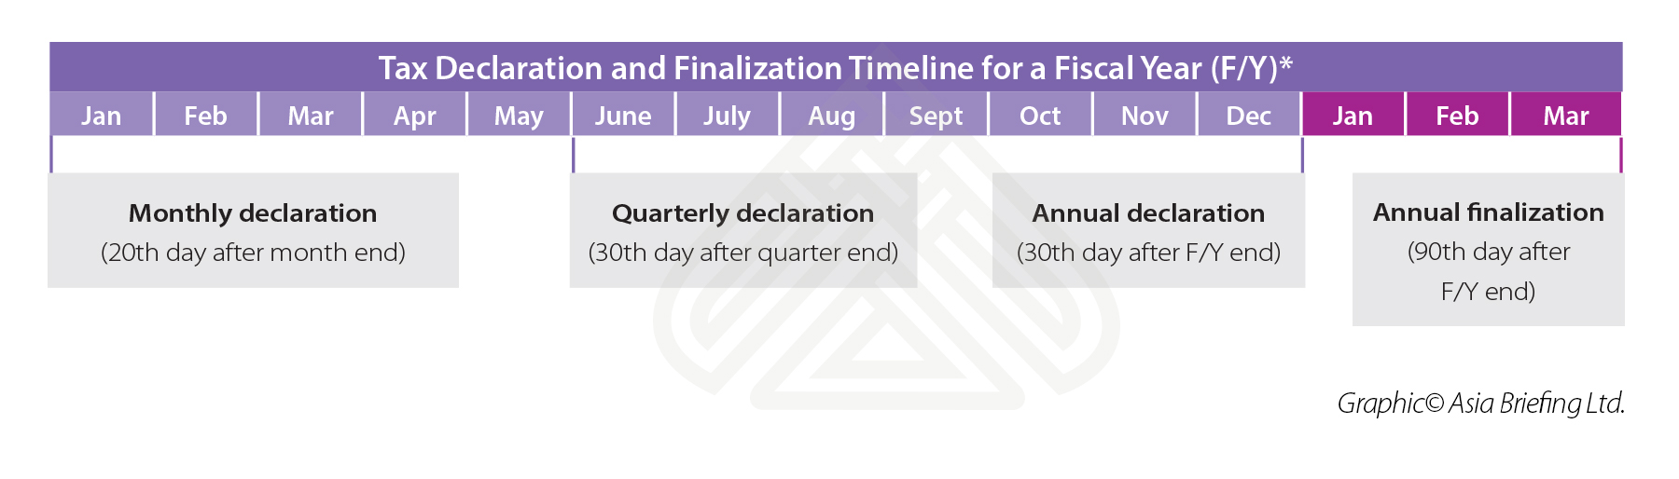
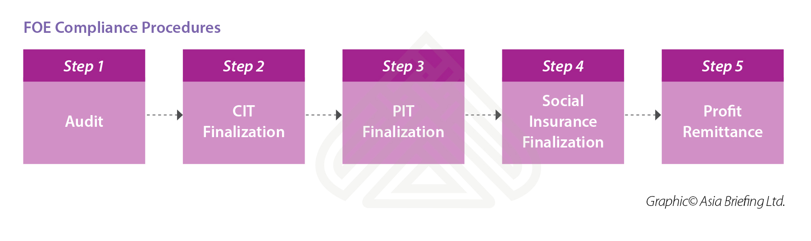
Accounting & Compliance Procedures

Slide 33

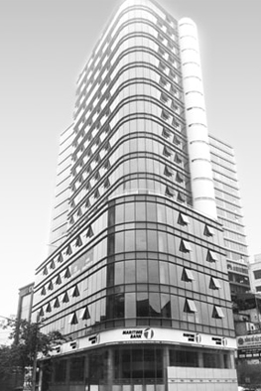
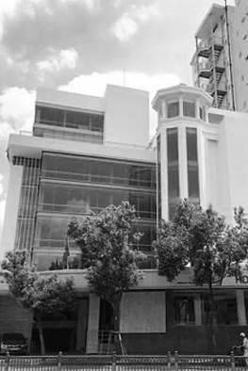
Our Practice in Vietnam
Hanoi
hanoi@dezshira.com
+84 4 3942 0443
Room 901, Floor 9th, VID Tower 1 Building, 115 Tran Hung Dao Street, Hoan Kiem District, Hanoi
Ho Chi Minh City
hcmc@dezshira.com
+84 8 3930 2828 or +84 8 3930 2818
3th Floor, Anh Dang Building, 215 Nam Ky Khoi Nghia street, District 3, Ho Chi Minh City, Vietnam

