Slide 1
TRADE WAR
December 17th, 2018

Slide 2
Table of Contents
Overview
A Time Line
Impact on the Business Environment in South China
Measures taken by Guangdong Province
End of the Trade War
Strategies for Addressing Tariffs
Case Study

Slide 3
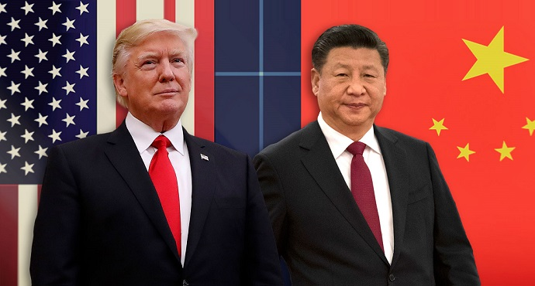
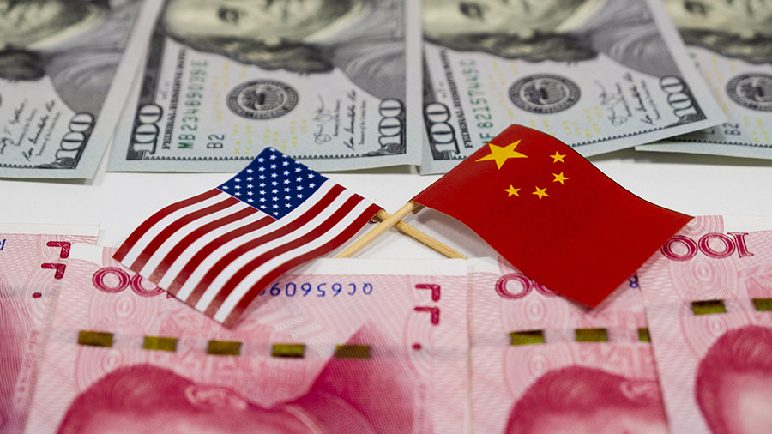
Overview
The US and China have been locked in a trade battle since July this year.
Until now, the US has applied exclusively to China: US$ 250 billion worth of Chinese products.
Total Chinese tariffs applied exclusively to US: US$ 110 billion.
Business on both sides, from a variety of industries, are starting to feel the effects.
After a work dinner on the sidelines of the G20 meetings in Buenos Aires, Argentina, on Dec. 1, a “truce” was achieved.
A temporary 90-day ceasefire (until March 1st , 2019) to deescalate trade tensions between the world’s two largest economies and reach a deal.

Slide 4
A time line

Slide 5
EVENTS LEADING TO TRADE WAR
Republican Candidate Donald Trump hard line on trade deficit.
“America First”
Aug. 17, 2017 -The USTR launches Section 301 Trade Act of 1974 investigation of China for unfair practices
US-China on-going trade talks. Failed
The case of ZTE

Slide 6


TIT-FOR-TAT. THE TARIFF BRINKMANSHIP GAME
1st round of tariffs
25% 818 products / US$34 bn
25% 545 products / US$34 bn
Aug. 23th
2nd round. 25% on 279 products worth US$16 bn
2nd round. 25% on 333 products worth US$16 bn
Sep. 24th
3rd round. 10% over 5,745 products worth US$200 bn.
To increase to 25% on January 1st.
-25% on 2,943 products (agricultural, foods, textiles, chemicals)
-20% on 1,078 (foods, paperboard, chemicals, works of art)
-10% on 974 (agricultural, chemicals, glassware)
-5% on 662 products (chemicals, machinery, medical equipment).

Slide 7

TIT-FOR-TAT. THE TARIFF BRINKMANSHIP GAME
November 19.
The US Bureau of Industry and Security (BIS) publishes proposed export control rules on emerging technologies for public comment.
Artificial intelligence (AI) robotics, and quantum computing could be subject to export controls because they are dual-use technologies that could be used for military purposes.
The rules do not specify China, but are widely considered by observers to be related to US efforts to prevent China from acquiring sensitive technologies.

Slide 8
TIT-FOR-TAT. THE TARIFF BRINKMANSHIP GAME
U.S. imports from China
Aug
Sep
Proposed tariffs
$50bn
$200bn
$267bn
$505bn
2017 total imports
Chinese imports from US
Aug
Sep
$50bn
$60bn
$130bn
2017 total imports

Slide 9
OTHER TACTICS…
Action against specific companies
Restriction of tourism
Currency devaluation
International No-Cooperation

Slide 10
Impact on the Business Environment in South China

Slide 11
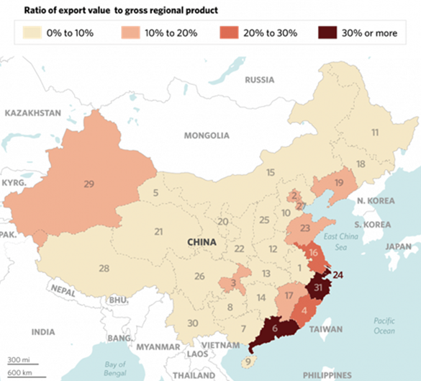
Effects in Guangdong
Chinese coastal provinces and cities feel the hardest of US tariffs.
Guangdong, Shanghai, Zhejiang, Jiangsu receive the most economic and employment stress.
The exports of these account over 30% of Chinas’ GDP.
Exports of electronic machinery (major US tariff target) account over 60% of total exports of:
-Guangdong: 67.8 %
-Jiangsu: 65.8%
-Shanghai: 60%
Source: Ministry of Commerce, National Buraeu of Statistics. Copyright Stratfor 2018
Stratfor. Aug. 31, 2018. “These are the areas where U.S. tariffs will hit China hardest”.
https://worldview.stratfor.com/article/these-are-areas-where-us-tariffs-will-hit-china-hardest

Slide 12
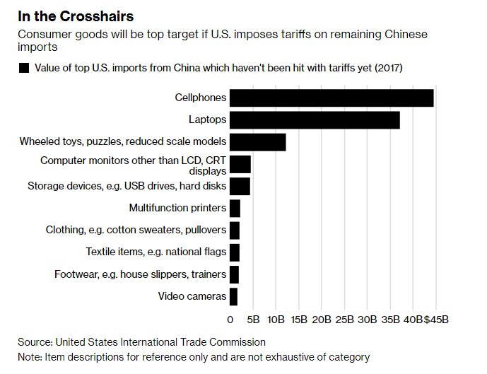
If remaining tariffs are applied…

Slide 13
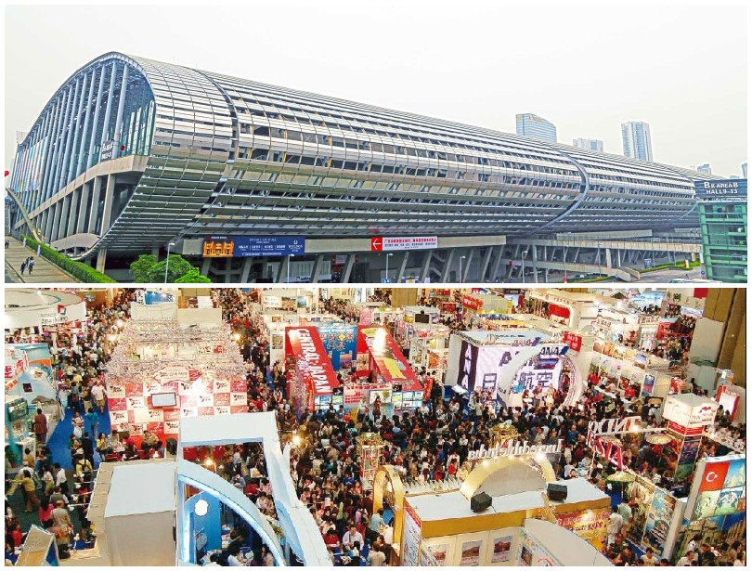
CANTON FAIR – A Thermometer
Canton fair brings together more than 25,000 exhibitors and 200,000 buyers (mostly foreigners). Held twice per year.
Supply chains of low-end commodities from Vietnam, India, Bangladesh, even Easter Europe
If US market is lost in the process, ready to find other markets.
Producers in China will not absorb cost of tariffs, but transfer to end-users/American consumers.
Finding partners to circumvent tariffs.
Rapidly growing domestic market act as rock-base for global supply chain.
For US exporters, while competition, language barriers and entering a difficult market has always been a challenge, tariffs now made US products less desirable for Chinese buyers.

Slide 14
Other effects in Guangdong
Guangdong – “Front-loading” orders
In Guangdong, economy expanded 6.9 per cent during the first three quarters of 2018, compared to previous year.
The stronger export figures can be interpreted as part of the front-loading order many local companies overtake before the application of tariffs.
Chinese exports of chemicals, non-ferrous metals, plastics and special industrial machinery were the fastest growing Chinese export categories in September.
Local companies that use US inputs are also being affect. Increased cost of components (10% to 25%?) creates the need to increase price or find different country providers.
Adding to previous rising cost of operations (labor, rent, raw material) profits may be on the way of decreasing further.

Slide 15
American Chamber South China Special Report on the Impact of U.S. and Chinese Tariffs
Amid an escalating US-China trade tensions, the American Chamber South China prepared a special report on the impact of U.S. and Chinese tariffs.
Survey conducted Sept 21 to Oct. 10
Study reflects the views of 219
Nearly half of respondents originated from the U.S., one third from Mainland China, and one fifth from other countries.
More than 60% of the surveyed companies have established business operations based in China and the U.S. market.
Type of Legal Entity | Business Activities in China
WFOE – 50% | Providing goods or services in China for Chinese market – 36%
Local Chinese company – 28% | Produce or source goods or services in China for the US market – 11%
JV – 14% | Produce or source goods in China for other markets – 16%
RO – 6% | Import good in China – 4%
Others – 1% | Others – 33%

Slide 16
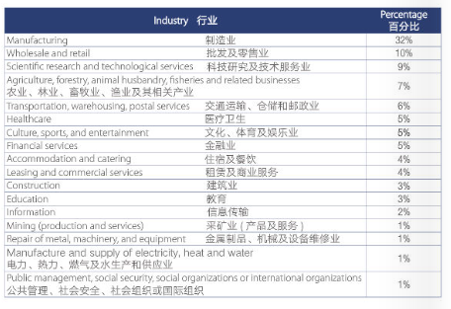
Industry
AmCham South China – “Special Report on the Impact of U.S. and Chinese Tariffs. October 26, 2018. pp. 8

Slide 17
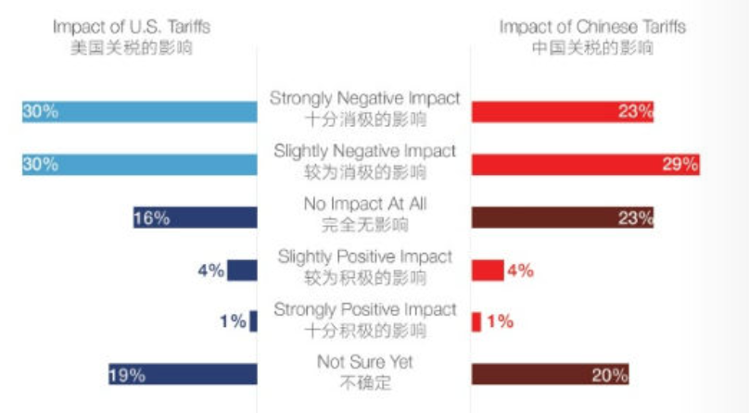
Impact of Combined Tariffs on Business
AmCham South China – “Special Report on the Impact of U.S. and Chinese Tariffs. October 26, 2018. pp. 10

Slide 18
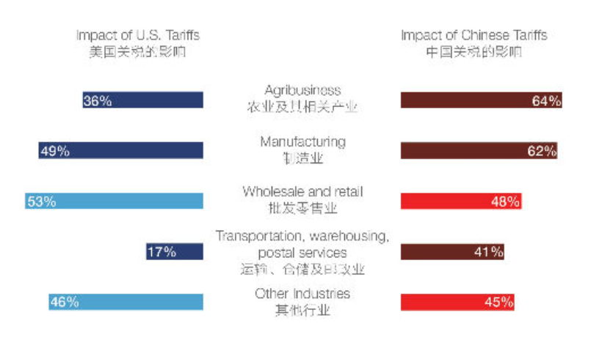
Impact of Combined Tariffs on Business
AmCham South China – “Special Report on the Impact of U.S. and Chinese Tariffs. October 26, 2018. pp. 11

Slide 19
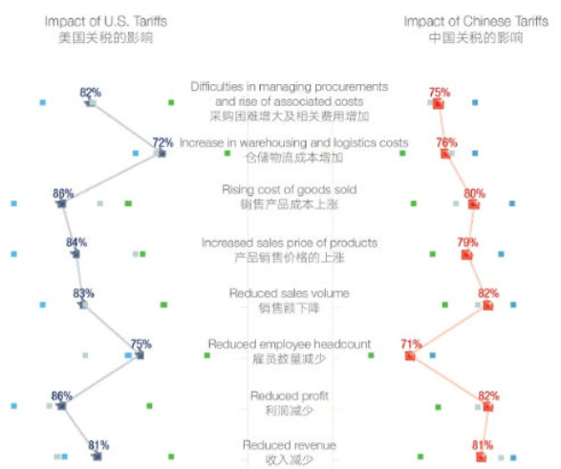

Negative Impact of Combined Tariffs on Business Operation (By Origin)
AmCham South China – “Special Report on the Impact of U.S. and Chinese Tariffs. October 26, 2018. pp. 13

Slide 20
AmCham South China – “Special Report on the Impact of U.S. and Chinese Tariffs. October 26, 2018. pp. 19

Slide 21
Measures taken by Guangdong Province

Slide 22
Measures Taken By Guangdong Province
On September 13, Guangdong province announced a series of investment incentives and cost cutting measures to offset impact of trade war:
Allows foreign investors to set-up WFOEs to produce special purpose and new energy vehicles (NEVs), drones, and other high-tech industries. (Previously, only JV).
Cancels the foreign equity limits of Chinese banks and financial asset management companies. Allows foreign banks to set up JV with 51% ownership
Cash rewards up to RMB 1000 million (US$ 14.59 million) for FIEs that establish regional HQ in the province. Foreign-invested R&D institutions can apply for subsidies up to RMB 10m (US$1.46m)
Full implementation of “One Window, One Form” policy to streamline business registration
Accelerate the China (Guangdong) Intellectual Property Center.
Between 2018-2020, investment over RMB 480 billion (US$65.65 bn) in industries such as: artificial intelligence, green technology, high-end equipment, new materials, and bio-tech.

Slide 23
Dezan Shira & Associates Assessment:
Partly designed to withstand the escalating trade war with the US.
Largely address structural changes to the nature of Guangdong’s economy. After years of rapidly rising land and labor costs in Guangdong, many low-value manufacturers have been relocating to lower-cost locations like inland China, Vietnam, and India.
Taken together, not designed to lessen the burden on smaller low-value manufacturers that are the most vulnerable in the trade war.
Seek to expedite Guangdong’s transformation into a high-tech manufacturing power in future industries
As a result, the measures only serve to accelerate pre-existing dynamics; promoting investment in emerging strategic industries while leaving those most vulnerable to the trade war exposed and potentially facing relocation and other financial stress.

Slide 24
End of the Trade War

Slide 25
The 90-days Cease Fire Trade Truce
On December 1st, US President Trump and Chinese President Xi struck a temporary 90-day ceasefire to deescalate trade tensions, after work dinner at the G20 meetings in Buenos Aires, Argentina.
With the ceasefire, tariffs will remain in place and avoided the increase of tariffs from 10% to 25% on the latest US$ 200 billion worth of goods. Tariffs will not be increased for 90 days, until March 1st. 2019.
The US will not implement further tariffs on all remaining Chinese exports (worth approx. US$267 billion worth of products).
China will not increase tariffs during this period.
According to a statement from the White House, China will purchase a “very substantial” amount of agricultural, energy, industrial, and other products to reduce the bilateral trade imbalance

Slide 26
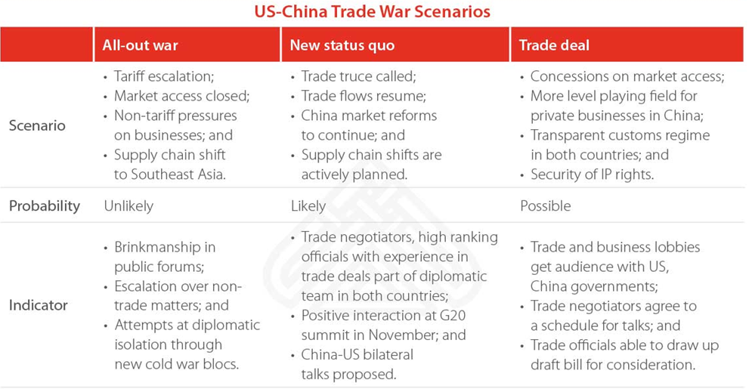

Slide 27
Dezan Shira & Associates comments:
The truce, although temporary, is a positive sign towards a resolution of the trade war.
Nevertheless, differences between the statements by the US and China suggest that the two sides hold substantial gaps about expectations for negotiations, example:
The Chinese statement (and official Chinese media) does not mention the 90-day deadline, only that tariffs will not be raised for the time being and that the two sides will negotiate.
Chinese statement omits some of the US language and tends to refer to its commitments in broader terms
Not mentioned by US, but by China, that the two sides agree to boost market access and will work toward scrapping all tariffs.

Slide 28
Dezan Shira & Associates Observations:
First Quarter of 2019 will be pivotal for determining effects of the trade war on demand from China.
Difficult to judge which markets will be the biggest drivers of growth for local companies.
No clear yet what are the overall impact on a complex global economy.
Problem of the tariff brinkmanship game: once tariffs are in place, these are difficult to remove.
Foreign businesses should continue to make contingency plans to reduce their exposure to extra tariffs and other supply chain risks arising from the dispute.

Slide 29
STRATEGIES FOR ADDRESSING TARIFFS

Slide 30

How to Respond to the Trade War
Step
1
Impact Assessment
Understand HS codes of all inputs and finished goods.
Understand where inputs are sourced from (are any from the US?)
Understand what finished goods are exported to the US and where else the goods are exported to (EU?)
Assess tariff exposure for US sourced inputs and US destined finished goods.

Slide 31

How to Respond to the Trade War
Step
2
Risk Mitigation
Assess opportunities to reclassify goods (not usually a big opportunity)
Develop stockpiles in US where possible to keep gaining time.
Explore options to outsource production to Emerging Markets in neighboring countries as a stopgap solution.

Slide 32

How to Respond to the Trade War
Step
3
Risk Management
Identify and assess the feasibility of alternative markets for production and distribution.
Understand and the assess the feasibility of entry strategies into these markets.
Diversification of distribution markets (more exports to the EU / ASEAN)
Relocate basic manufacturing and assembly to neighboring markets (China +1)

Slide 33
Tariff Analysis Strategy
Assess Exposure
NO
NO (Relocation)
Reclassify
Tariffs
Reclassification possible?
Cross-Boarder Supply Chain Possible / Feasible?
YES
(China +1)
Select a country for China +1
Identify an optimal location for manufacturing within selected country
Incorporate entity within country

Slide 34




Manufacturing in third party markets to avoid tariffs
RELOCATION STRATEGY
B
ACFTA
A
GSP
MFN
A: Majority of production in China; goods sent directly from China to the United States
B: Inputs supplied from China under ASEAN China FTA; goods are finished in ASEAN facilities; finished products are exported to United States under US GSP or US’s MFN obligations.
Tariffs
Key Terms
ACFTA: ASEAN China Free Trade Agreement
MFN: Most Favored Nation Status
GSP: Generalized System of Preferences
www.dezshira.com
35

Slide 35
CASE STUDY

Slide 36
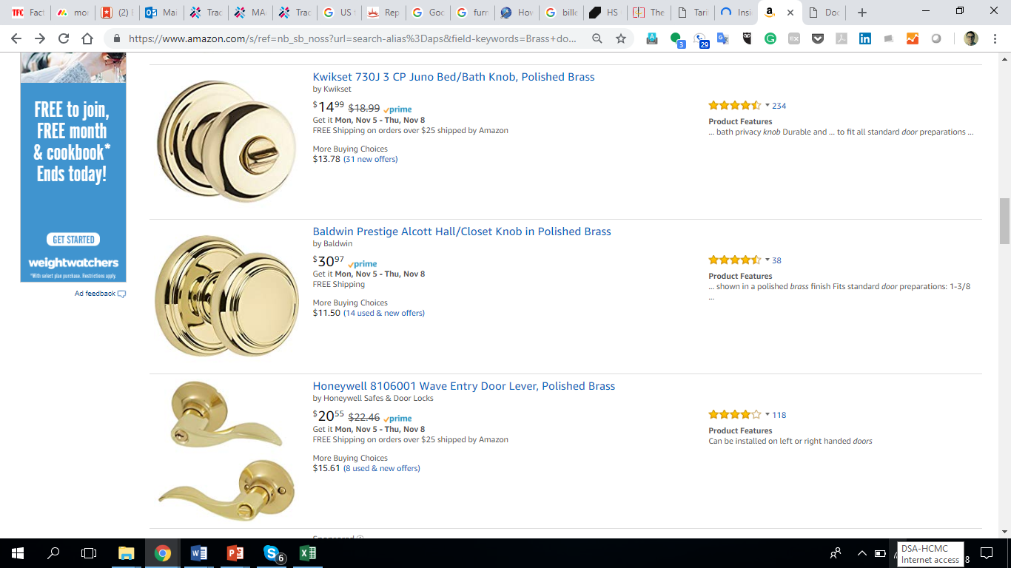
Case Study Overview
Company Profile
Issues
US based company
Company only makes Door Knobs
Company has warehouses in the United States that will help them mitigate tariffs in the near term
Company does not export to any market other than the United States
Company does not wish to outsource its manufacturing to a third party
Company heard about the trade war and its potential impact on their operations. With this in mind, they wished to understand the following:
Their current and future exposure to US Tariffs
Available options to retain operations within China
Alternative markets to shift production with an emphasis on their tariff exposure
Products
Brass Door Knobs
Door Knobs are manufactured from copper billets

Slide 37
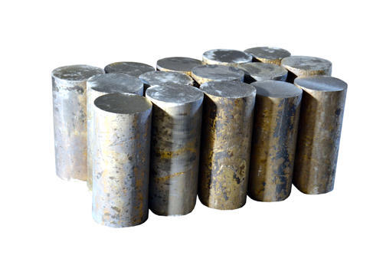
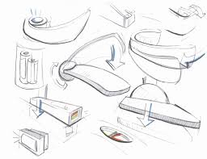

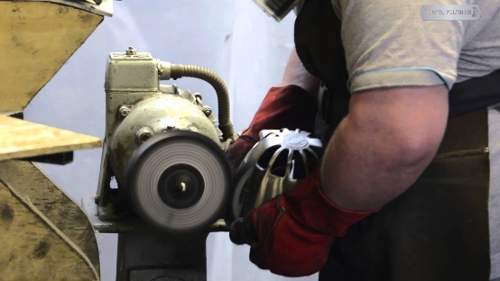


The Door Knob Manufacturing Process
Design
Raw Material Sourcing
Forging
Surface Preparation
Coating
Export

Slide 38
HS Code Classification for Door Knobs
Door Knob Inputs
Copper billets are the main input for door knobs. These are classified under HS 7403.13
Note: Design services carried out in China are unlikely to impact the good’s origin
Final Product
Finished door knobs are commonly exported under HS code 8302.41

Slide 39
Current and Future Exposure of Door Knobs to Tariffs
Past, Current, and Planned Tariffs
Current Pricing on Amazon
Potential Impact on Pricing
MFN
US$14.99
+10%
US$16.48
+25%
US$18.73
Note
Despite being in effect, tariffs are unlikely to result in price changes until company stockpiles are depleted. Many companies boosted imports to avoid paying taxes.
The cost to manufacture an individual door handle is in reality much lower than prices that are posted on Amazon.

Slide 40



Tariff Reclassification of Door Knobs
Current US tariffs do NOT leave room for reclassification. All related HS codes shown below are also subject to US tariffs:
Neighboring HS Codes
Integration with More Complex Products
All HS codes close to companies HS code of HS 8302.41 are subject to US tariffs.
8302.10.60, 8302.10.90
8302.20.00, 8302.30.30
8302.30.60, 8302.41.30
8302.41.60, 8302.41.90
8302.49.20, 8302.49.40
Products that make use of companies product, such as doors or drawers, are also subject to US tariffs.
US
Tariffs

Slide 41
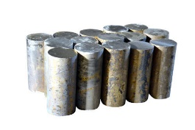
Relocation of Door Knob Manufacturing
1
2
3
ACFTA
GSP
MFN
Proposed Operational Structure
4
1. Design & Raw Material Sourcing + any other processed
2. Ship copper billets to third party
3. Undertake forging, surface prep, and coating in third party market.
4. Ship finished door knobs to the United States
www.dezshira.com
42

Slide 42

Assessing Exposure of Inputs (Billets) to Tariffs
Copper Billets
ACFTA
HS 7403.13
Importing country | Tariff regime | Total ad valorem equivalent tariff
Cambodia | ACFTA | 0%
India | MFN | 5.00%
Indonesia | ACFTA | 0%
Philippines | ACFTA | 0%
Myanmar | ACFTA | 0%
Thailand | ACFTA | 0%
Viet Nam | ACFTA | 0%
ACFTA
ACFTA removes tariffs on billets being shipped from China to all ASEAN markets.
Companies will need to comply with rules of origin requirements to qualify for tariff exemption
China to India
China and India’s bilateral and multilateral tariff concessions do NOT remove all tariffs.

Slide 43

Analyzing ACFTA Rules of Origin
How will inputs be classified?
What does the company or its suppliers need to do to qualify?
Inputs can be classified as originating in China if they are wholly produced in China (metal comes from China) or they are substantially transformed in China (formed into billets within China)
Companies will need to document elements of their production process and products in accordance with the local customs requirements in third party markets where billets are being shipped.
Key requirements:
1. Factory Registration
Company must first apply for registration using the stipulated form (see table next page). Upon registration, customs agency inspects the applicant’s factory to check on the production process, and confirm manufacturing operations, machinery and manpower, and updated production records.
2. Prepare manufacturing cost statement
Company must prepare manufacturing cost statement (MCS) for each product in order to prove local value content and/or change in tariff heading meets the RO as stated in respective FTA. MCS is usually valid for one year.
Will inputs qualify for tariff exemption?
For Billets to qualify, 40% of the FOB value must be derived from within ASEAN or China.

Slide 44
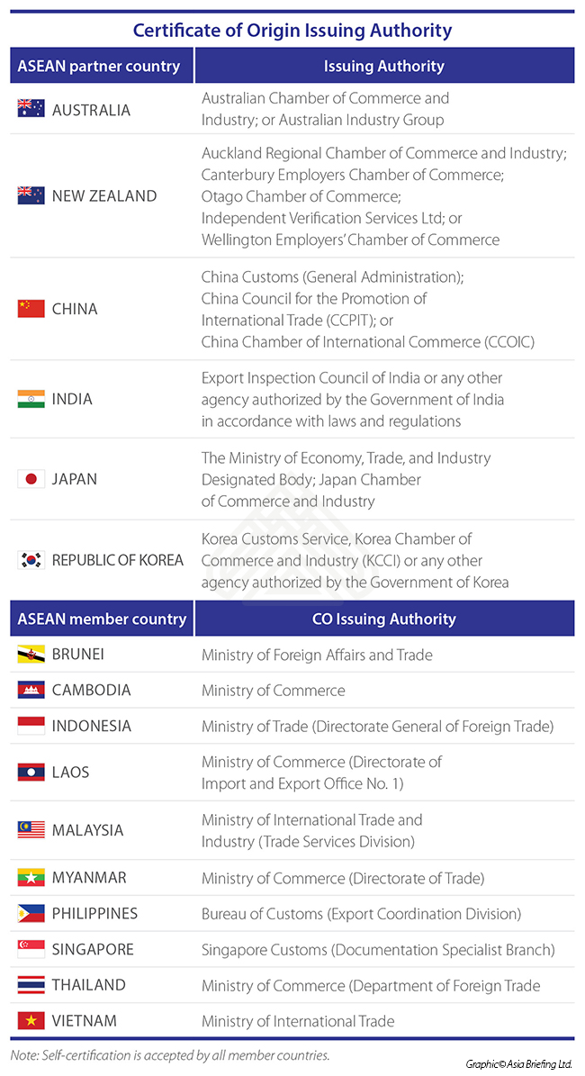
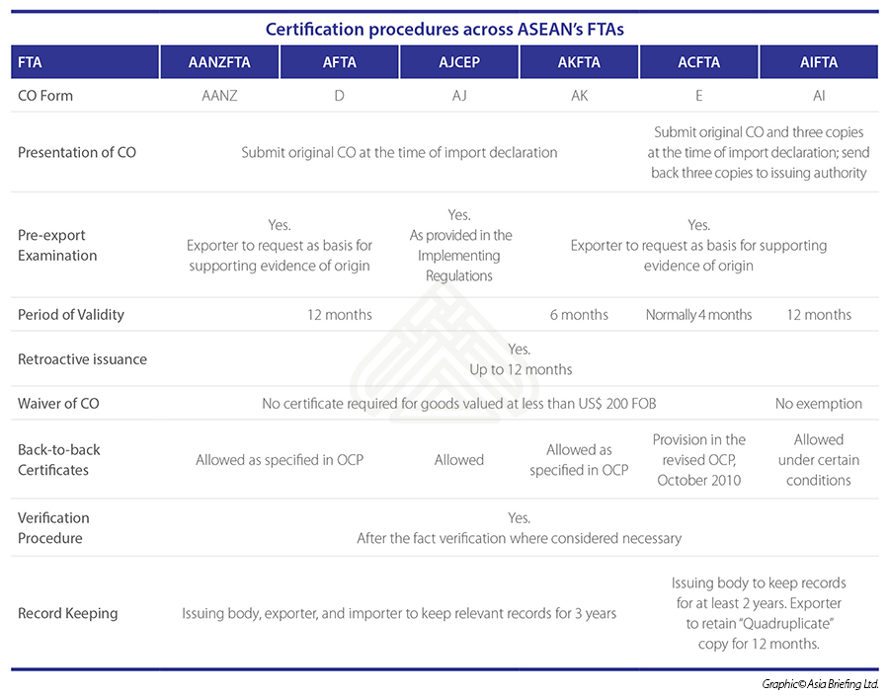
Analyzing ACFTA Rules of Origin
Authorities
To benefit from tariff coverage under ACFTA, Company will be required to work with relevant authorities to ensure compliance requirements outlined below
Compliance

Slide 45



Assessing Exposure of Door Knobs to US Tariffs
Door Knobs
GSP
HS 8302.41
Exporting country | Tariff regime | Applied tariff (as reported)
Cambodia | MFN duties (Applied) | 3.50%
 | Preferential tariff for GSP countries | 0%
India | MFN duties (Applied) | 3.50%
 | Preferential tariff for GSP countries | 0%
Indonesia | MFN duties (Applied) | 3.50%
 | Preferential tariff for GSP countries | 0%
Malaysia | MFN duties (Applied) | 3.50%
Myanmar | MFN duties (Applied) | 3.50%
 | Preferential tariff for GSP countries | 0%
Philippines | MFN duties (Applied) | 3.50%
 | Preferential tariff for GSP countries | 0%
Thailand | MFN duties (Applied) | 3.50%
 | Preferential tariff for GSP countries | 0%
Viet Nam | MFN duties (Applied) | 3.50%
US Generalized System of Preferences (GSP)
All counties will provide significant tariff relief compared to tariffs currently applied to Chinese exports.
US GSP provides tariff reductions for developing countries. Many countries assessed will qualify for US GSP.
What about Vietnam?
Vietnam and China are both ineligible for US GSP because of a cold war era line in GSP which disqualifies communist countries from receiving assistance.

Slide 46

Analyzing US GSP
What countries are eligible?
Further Clarification
Thailand, Philippines, India, Indonesia, Cambodia, and Myanmar are all eligible for GSP benefits
An importer, exporter or producer who is uncertain about whether a particular imported article satisfies the rules of origin requirements, may check CROSS, CBP’s searchable database, http://rulings.cbp.gov/, to see if CBP has issued a ruling on the same or a similar product, or may contact CBP for a binding ruling.
Will proposed manufacturing satisfy rules of origin provisions?
For an imported article to be GSP-eligible, it must be the growth, product, or manufacture of a Beneficiary Developing Countries (BDC), and the sum of the cost or value of materials produced in the BDC plus the direct costs of processing must equal at least 35 percent of the appraised value of the article at the time of entry into the United States. US Customs and Boarder Protection (CBP) is charged with determining whether an article meets the GSP rules of origin.
Note: All ASEAN countries eligible for GSP will be treated as a single country for the purpose of the rules of origin compliance.

Slide 47

Treatment of Vietnamese Goods
Changes are required for Vietnamese goods
Tariff Rate Applied
Prevailing customs legislation requires to the following to confer originating status to company’s product (8302.41):
  A change to subheading 8302.10 through 8302.60 from any other subheading, including another subheading within that group.
Vietnamese goods bound for the United States will be subject to standard customs treatment outlined under US WTO MFN obligations as the United States does not have a FTA with Vietnam.
Under US MFN Tariff Concessions, a rate of 3.5% is imposed on Vietnamese goods.
Company will be accustomed to this rate as its products in China, prior to the imposition of tariffs, were subject to the same rates.
What will Company be required to relocate?
Current HS classifications do not make a distinction between Door Knobs that are molded and those that have been finished – through the surface preparation and coating.
Furthermore, prevailing US customs legislation does not confer originating status based on the value added in a third party.
Company will be required to relocate forging processes

Slide 48
Shortlisting Relocation Options
Lowest Tariff Exposure
Additional Considerations (Beyond Tariff Analysis)
Country | Input Import liability | Export Liabilities
China | 0% | 10% / 25%*
Cambodia | 0% | 0%
India | 5.0% | 0%
Indonesia | 0% | 0%
Philippines | 0% | 0%
Malaysia | 0% | 0%
Myanmar | 0% | 0%
Thailand | 0% | 0%
Viet Nam | 0% | 3.5%
*Scheduled to go into force 01.03.2019
Labor
Domestic taxation
Logistics
Business Environment
Trade Connectivity
Domestic Suppliers
Infrastructure

Slide 49
Dezan Shira & Associates Findings
Company is currently exposed to 10% tariffs on its finished products
Company will face tariffs of 25% on its finished products from 01.03.2019
Tariff Reclassification cannot be feasibly achieved
Company’s inputs will qualify for coverage under ACFTA should they be imported into an ASEAN market
Company will be required to carry out manufacturing in a third party market, in additional to minimal finishing processes, in order to change the origin of its products.

Slide 50
Dezan Shira & Associates Recommendations
Evaluate potential countries for manufacturing taking into account tariff exposure and other aspects of doing business.
Shortlist potential locations for manufacturing within top candidate countries for relocation or China +1 manufacturing
Arrange site visits to all areas of interest to develop a better understanding of conditions on the ground
Analyze existing value chain to understand ability of surface preparation and coating to meet US GSP’s 35% content threshold

Slide 51
How can Dezan Shira & Associates help?

Slide 52
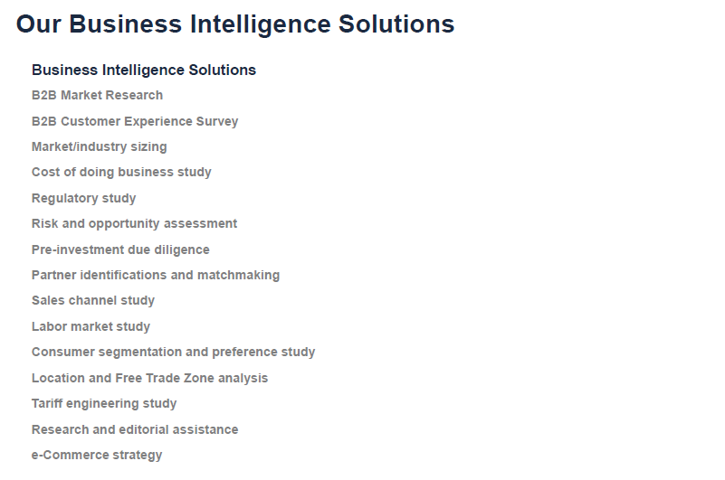
Notes:
o

Slide 53








DSA Service Suite
  Pre-Investment and Entry Strategy Advisory
  Accounting, Payroll, and Treasury
  Corporate and Tax Structuring
  Tax and Compliance
  Cross-border Transactional Support
  Employment law and HR
  Audit Financial Review, Due Diligence
  ERP and Financial System Advisory

Slide 54
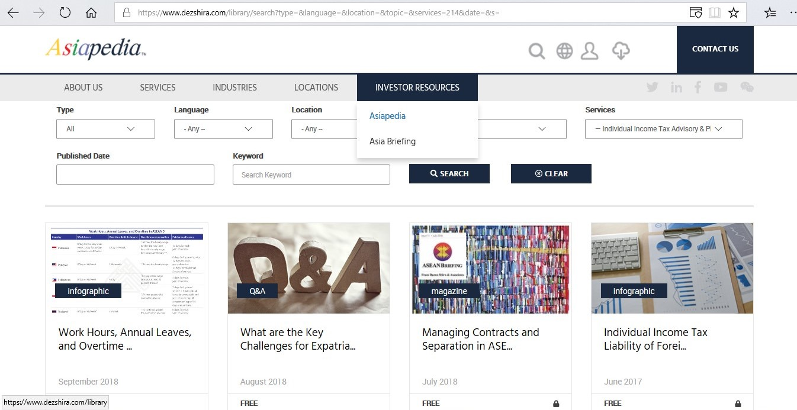
AsiaPedia
To learn more knowledge on doing business in Asia, Please visit AsiaPedia: https://www.dezshira.com/library

Slide 55
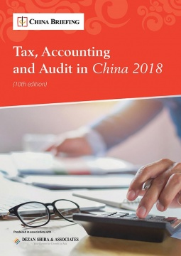
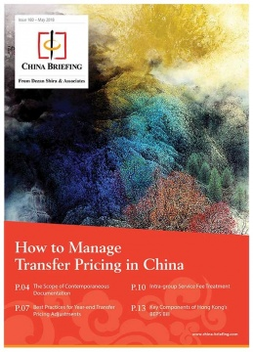
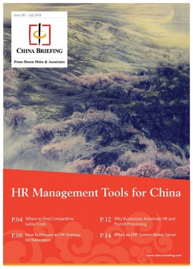
Asia Briefing HR Publications
For more business publications, Please visit Asia Briefing Bookstore: http://www.asiabriefing.com/store/

Slide 56



